Slide 1





Capstone Project Report
Artificial Intelligence and Machine Learning Fundamentals
Agricultural Raw Material Analysis
Student Details
Name: PAVITHRA S (2021109031)
NM Id: 1) A6100113313C337A8A2423D5EF2E66DA
2) au2021109031
College Name :College of Engineering Guindy, Anna University

Slide 2
COURSE OUTLINE:
Abstract
Problem Statement
Aims, Objective & Proposed System/Solution
Services and tools required
Project architecture
Execution and project outcome
Future Scope
Conclusion
Reference

Slide 3
ABSTRACT
The objectives of this study include identifying high-range and low-range raw materials based on their prices, analyzing the percentage change in prices over time for each material, determining the range of price changes over the years, and mapping the correlation between different raw materials. This project aims to provide valuable insights for stakeholders in the agricultural industry, including farmers, traders, and policymakers, to make informed decisions and mitigate risks associated with fluctuating raw material prices.

Slide 4
PROBLEM STATEMENT
The agricultural sector plays a pivotal role in the economy, with raw materials serving as essential inputs for various industries such as food processing, textiles,etc. Understanding the trends and dynamics of agricultural raw material prices is crucial for stakeholders across the supply chain to make optimize resource allocation, and mitigate financial risks. The focused problem statement of this project is to conduct an exploratory data analysis (EDA) of a dataset containing historical prices of agricultural raw materials. The analysis aims to provide insights into the trends, variability, and interrelationships among different raw materials' prices over time.

Slide 5
AIM AND OBJECTIVE
Some key aims and objectives:
Price Forecasting: One of the primary objectives is to forecast the future prices of agricultural raw materials
Risk Management: Analyzing agricultural raw material prices helps in identifying and managing price risks associated with agricultural commodities.
Supply and Demand Analysis: Understanding the factors influencing supply and demand for agricultural raw materials is essential for maintaining market equilibrium.

Slide 6
Market Competitiveness: Analyzing agricultural raw material prices provides insights into the competitiveness of domestic agricultural products in both domestic and international markets.
Policy Formulation: Policymakers utilize price analyses to formulate agricultural policies that promote stability, sustainability, and competitiveness in the agricultural sector.
Consumer Welfare: Price analyses contribute to ensuring consumer welfare by monitoring and regulating food prices.

Slide 7
PROPOSED SOLUTION
The proposed solution involves the obtaining of a comprehensive dataset containing historical prices of agricultural raw materials from reliable sources such as government agencies.
Identifying trends and patterns in price fluctuations for individual raw materials and providing the solutions.
Calculating the summary statistics such as mean, median, and standard deviation to understand the central tendency.
By implementing this proposed solution, stakeholders can gain valuable insights into agricultural raw material prices, enhance decision-making processes,etc.

Slide 8
SERVICES AND TOLS REQUIRED
SERVICES:
Machine Learning Services
APIs (Application Programming Interfaces)
Online Databases
Specialized Platforms
TOOLS AND SOFTWARE:
Google Sheets
Power BI
EXCEL SHEETS
Tableau

Slide 9
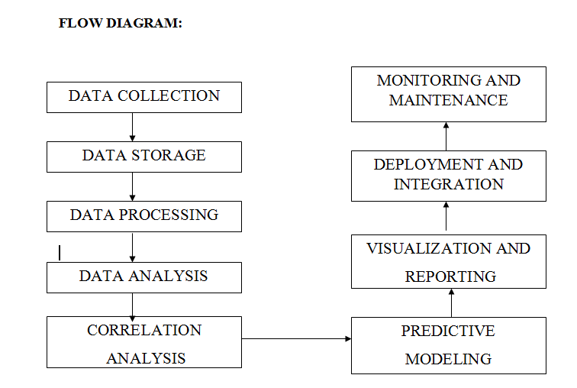
PROJECT ARCHITECTURE

Slide 10
EXECUTION AND PROJECT OUTCOME
The various steps to be followed during the execution phase are as follows:
Data Loading
Data Cleaning and Preparation
Calculate High-Range and Low-Range Raw Materials
Calculate % Change
Identify Price Range Changes
Correlation Analysis

Slide 11
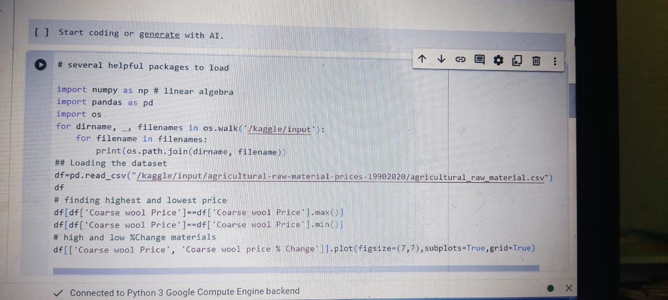
DATA LOADING AND IMPORTING SEVERAL PACKAGES:

Slide 12
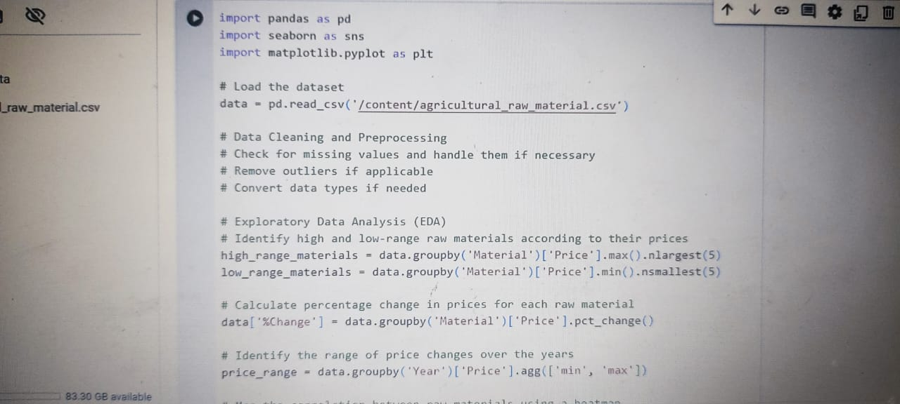
CODING AND EXECUTION PART:

Slide 13
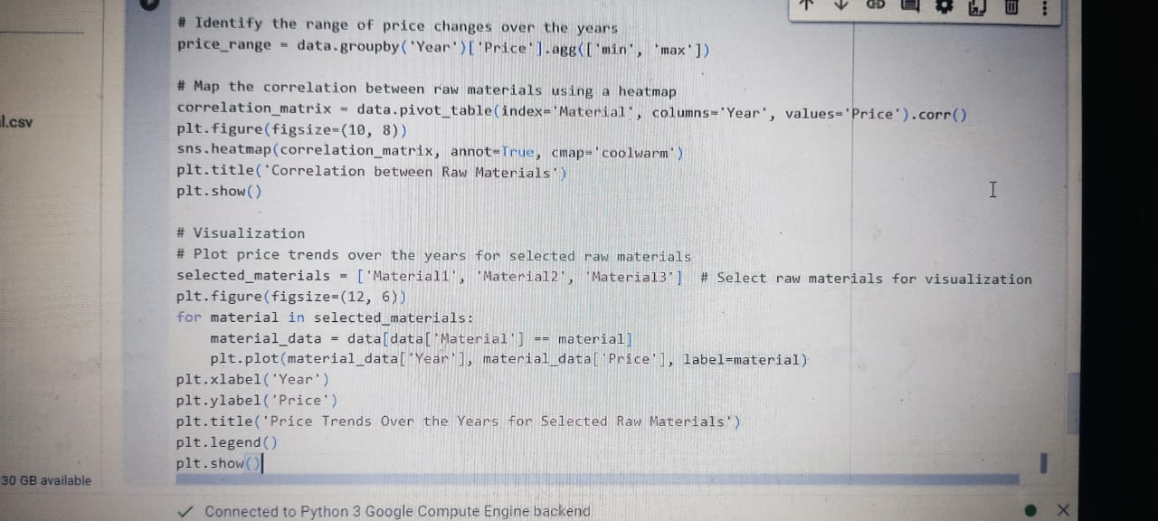

Slide 14
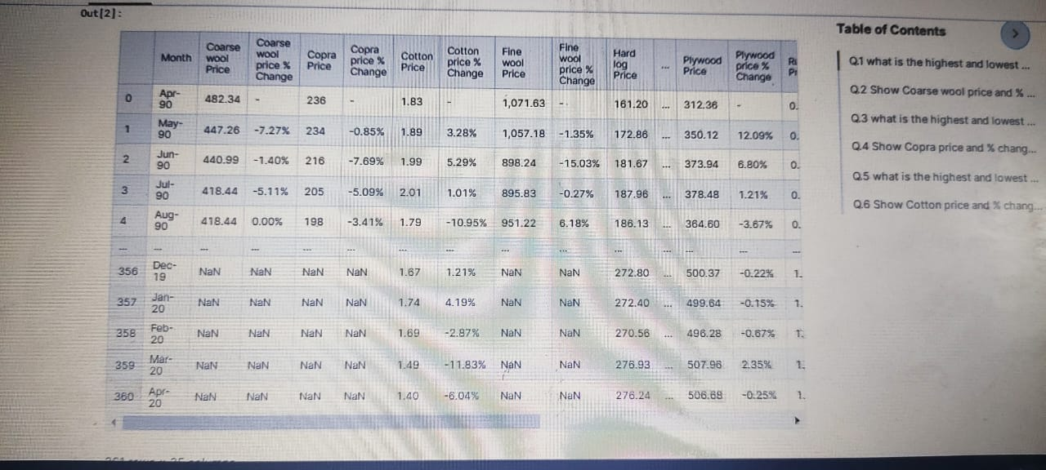
OUTPUT
Loaded dataset

Slide 15
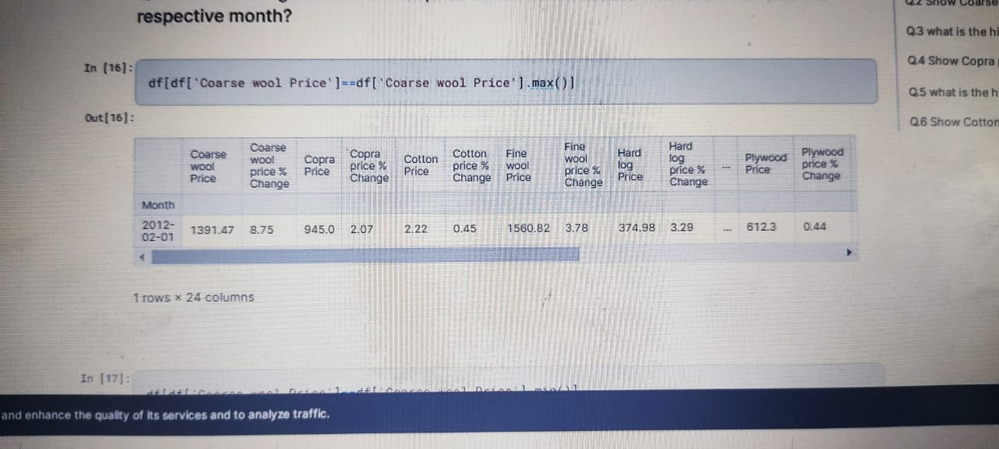
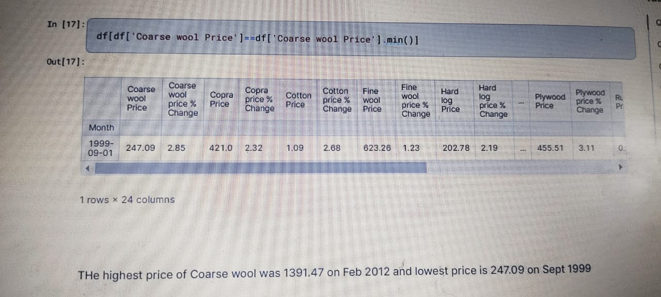
HIGH RANGE MATERIALS
LOW RANGE MATERIALS

Slide 16
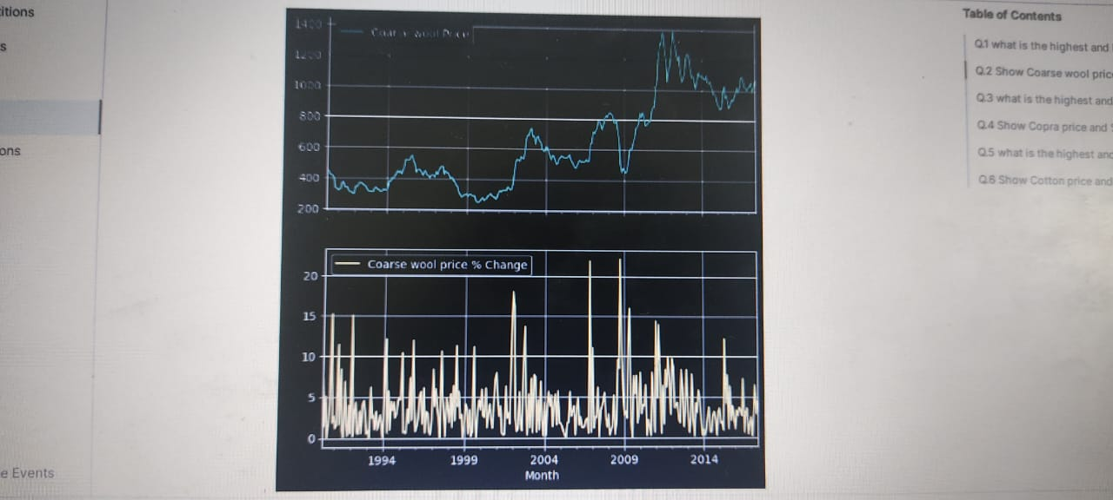
CALCULATE % CHANGE

Slide 17
FUTURE SCOPE
With advancements in data analytics, technology, and market intelligence, there are several areas where future research and development can add substantial value to the agricultural sector.
Firstly, leveraging machine learning and artificial intelligence algorithms can enhance predictive modeling capabilities, enabling more accurate forecasting of raw material prices.
Secondly, there is a growing opportunity to incorporate real-time data sources, such as satellite imagery, IoT sensors, and social media sentiment analysis, into price analysis frameworks.

Slide 18
CONCLUSION
In conclusion, the analysis of agricultural raw material prices provides valuable insights into market trends, price dynamics, and interrelationships among different commodities. Through exploratory data analysis (EDA) and statistical techniques, we have gained a comprehensive understanding of the dataset.
Overall, the analysis of agricultural raw material prices provides actionable insights for stakeholders across the agricultural value chain, including farmers, traders, processors, policymakers, and investors

Slide 19
REFERENCES:
https://medium.com/@guilhermelorenzetti12/this-project-consists-of-an-exploratory-analysis-of-a-dataset-covering-the-agricultural-raw-816b7b816055
https://jovian.com/danish-alam26/analysis-agriculture-raw-mateial-prices

